Slide 1
E-Grocery Store
Team Members
Dhana Lakshmi
Dileep Kumar
Harshada Hole
Sonu Kumar

Slide 2
Abstract
An online Grocery Store permits a customer to submit online orders for items and/or services from a store that serves both walk-in customers and online customers. The online Store system presents an online display of all the items they want to sell. This web based application helps customers to choose their daily needs and add products to their shopping cart. Customers provides their complete detail of address and contact and they get their chosen products in their home.
This Web application saves lots of time of customers .

Slide 3
Technologies used
Database:
Oracle Database 11g Express Edition
Back-End:
Java , Spring Boot
Front-End:
HTML CSS , JavaScript , ReactJs.

Slide 4
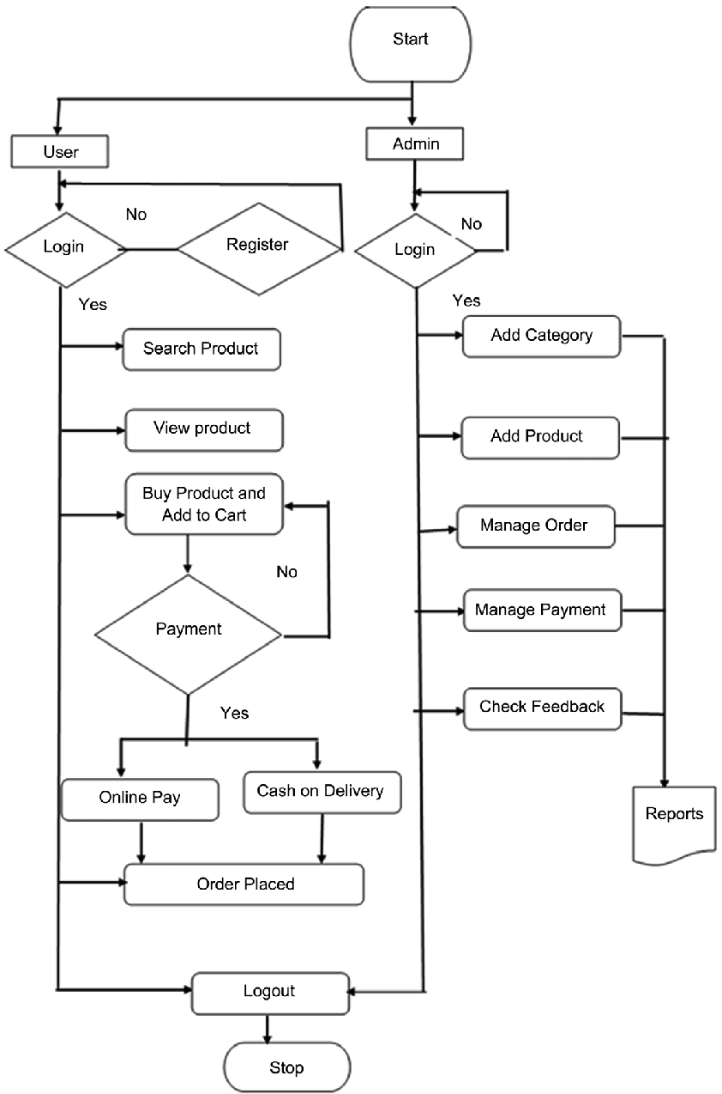
Activity Diagram

Slide 5
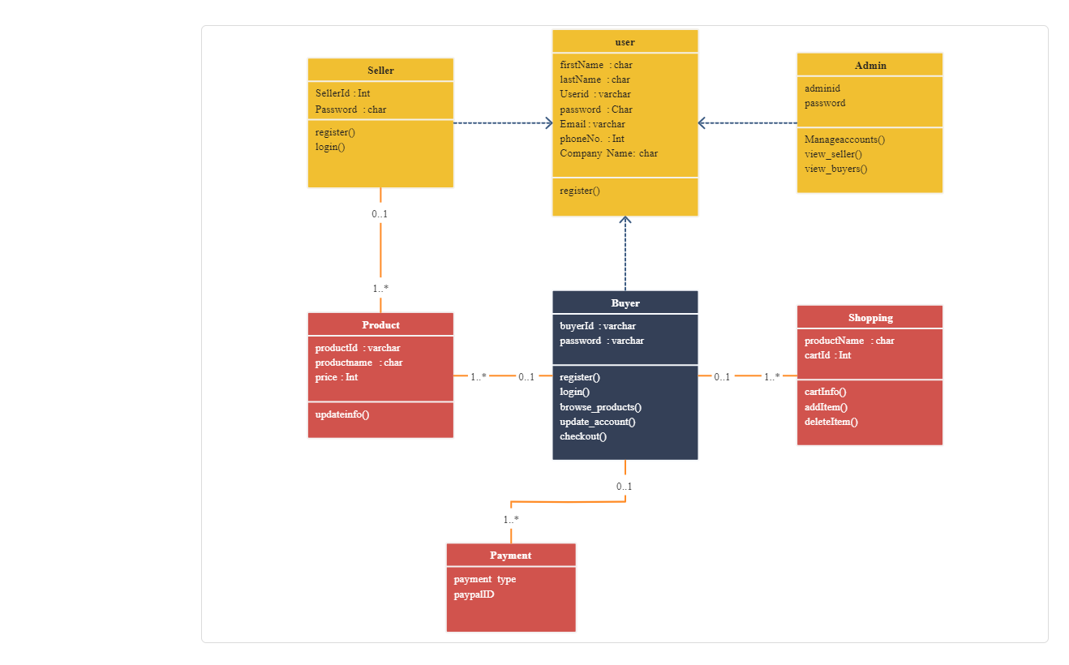
Class Diagram

Slide 6
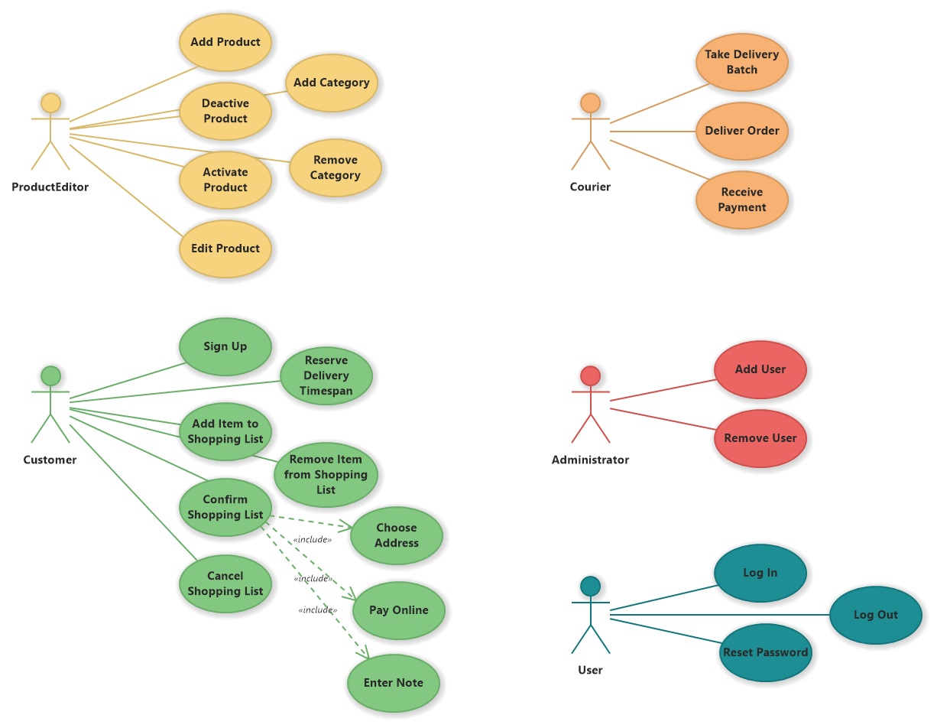
Case Diagram

Slide 7
User Module
The user module allows users to register, log in, and log out. Users benefit from being able to sign on because this associates content they create with their account and allows various permissions to be set for their roles.

Slide 8
Customer Module
The Customer Information module is a component of the Bill Advisor that displays a customer's basic account information after the account has been opened. This module contains the following information: Account Number: The unique identifier for the customer's account with the utility.

Slide 9
Product Module
The Products module is a catalogue of the products and services you are offering. Users have the possibility to create an enumerated database with descriptions and prices or to synchronize this with the accounting system.

Slide 10
Address Module
The address module makes storing, validating, displaying and publishing of addresses – international postal locations – efficient and uniform by providing a readymade input form with all the necessary fields included.

Slide 11
Cart Module
Cart module represents shopping cart management system. ... Cart module manages customers accumulated list of items, calculates a total for the order, including shipping and handling charges and the associated taxes.

Slide 12
Order Module
An ordering module allows you to change the order that a collection of items appear in cart and we can proceed for order.

Slide 13
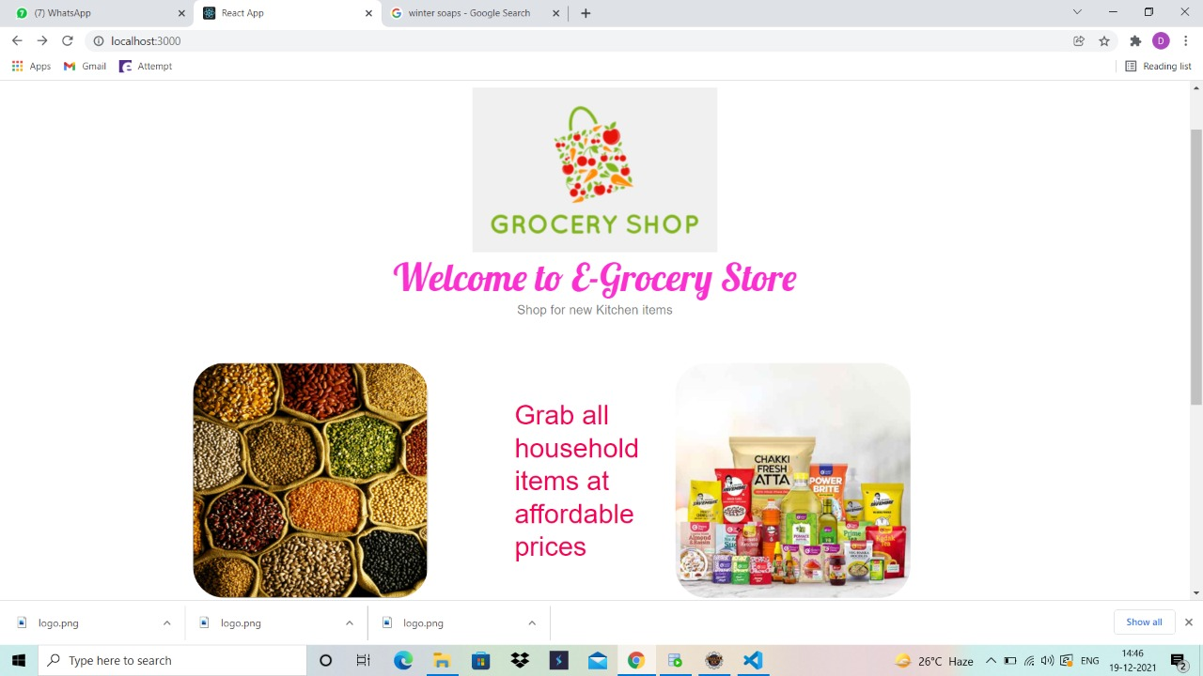

Slide 14
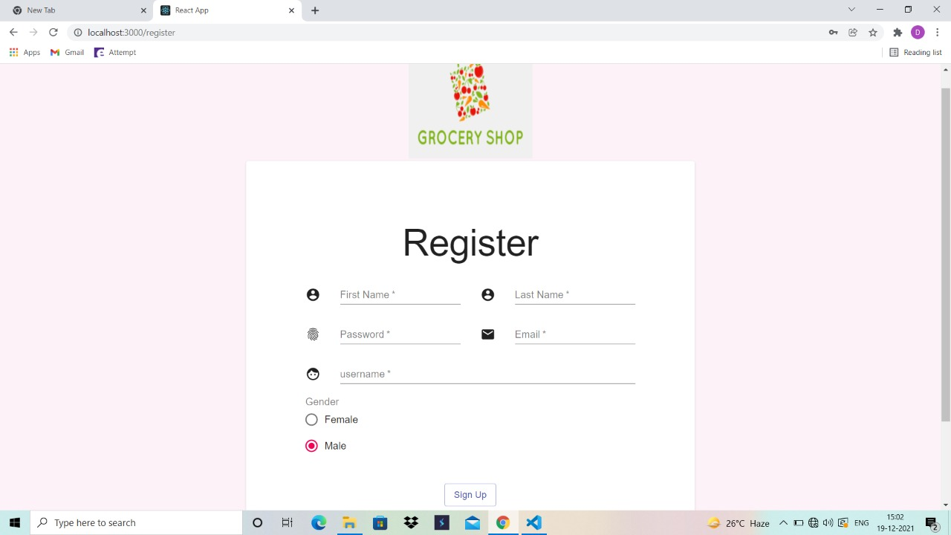

Slide 15
